Slide 1
British Airways Booking Estimation
11/1/2025

Slide 2
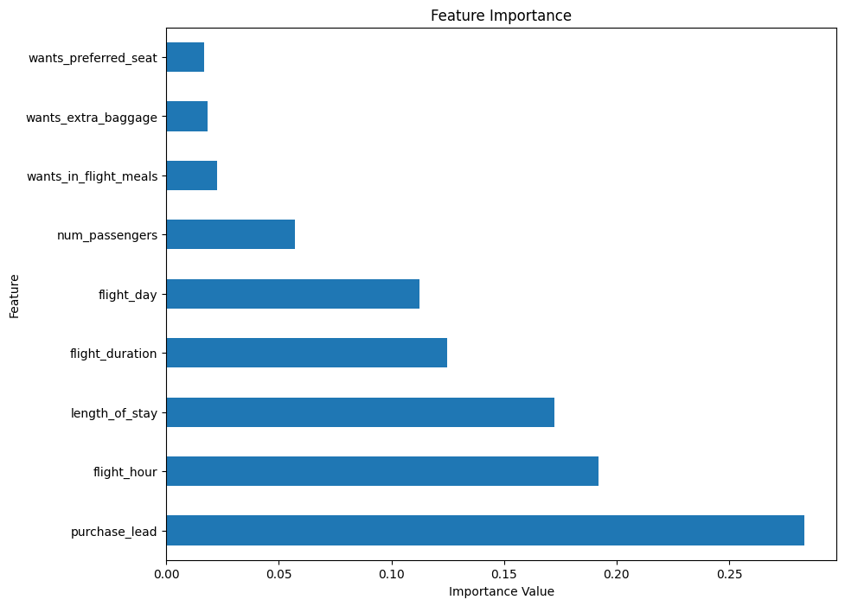
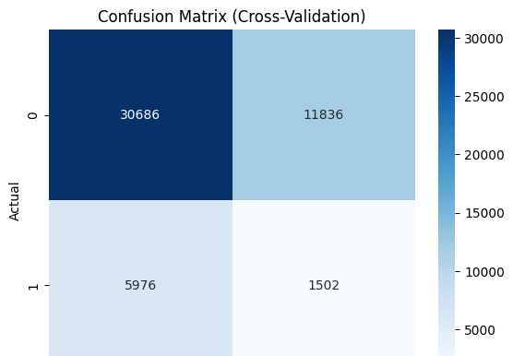
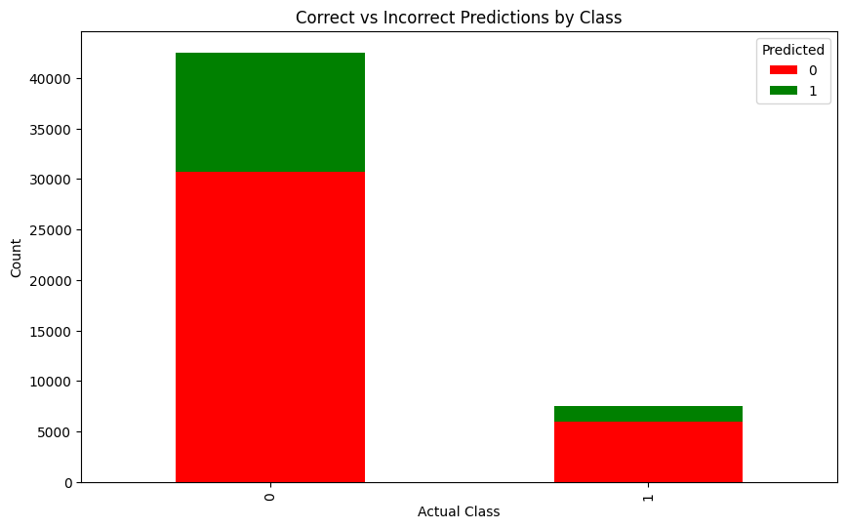
Results
The 5 most important features:
Purchase lead
Flight hour
Length of stay
Flight duration
Flight day
We used the RandomForest as the machine learning model to estimate booking behaviour. However, the model has a high precision on estimating unsuccessful booking, which is 84%. The estimation on successful booking is quite low, at a percentage of 11%. The model’s performance can also be seen from the confusion matrix below.
The average accuracy score from the cross-validation test is 0.64.

